Slide 1
I like running, walking and taking loads of pictures…
My name is Carla Moestafa. Indonesian living in Singapore with education background in chemical engineering and project management

Slide 2
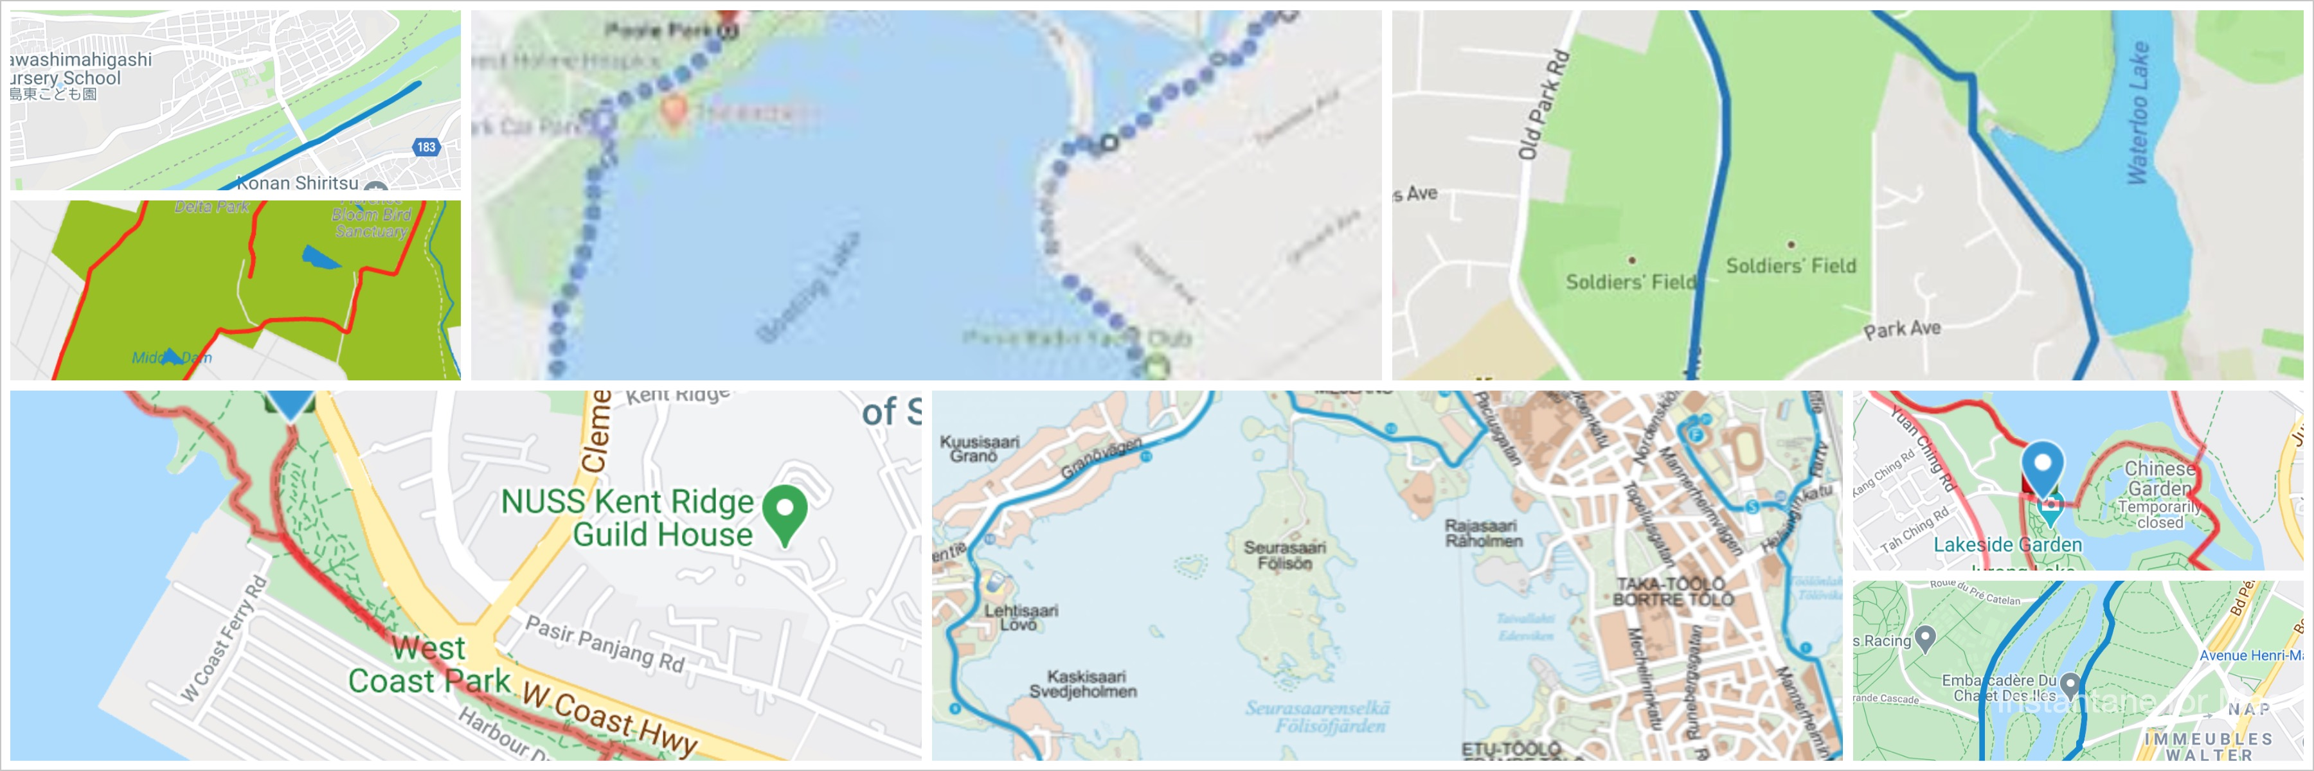
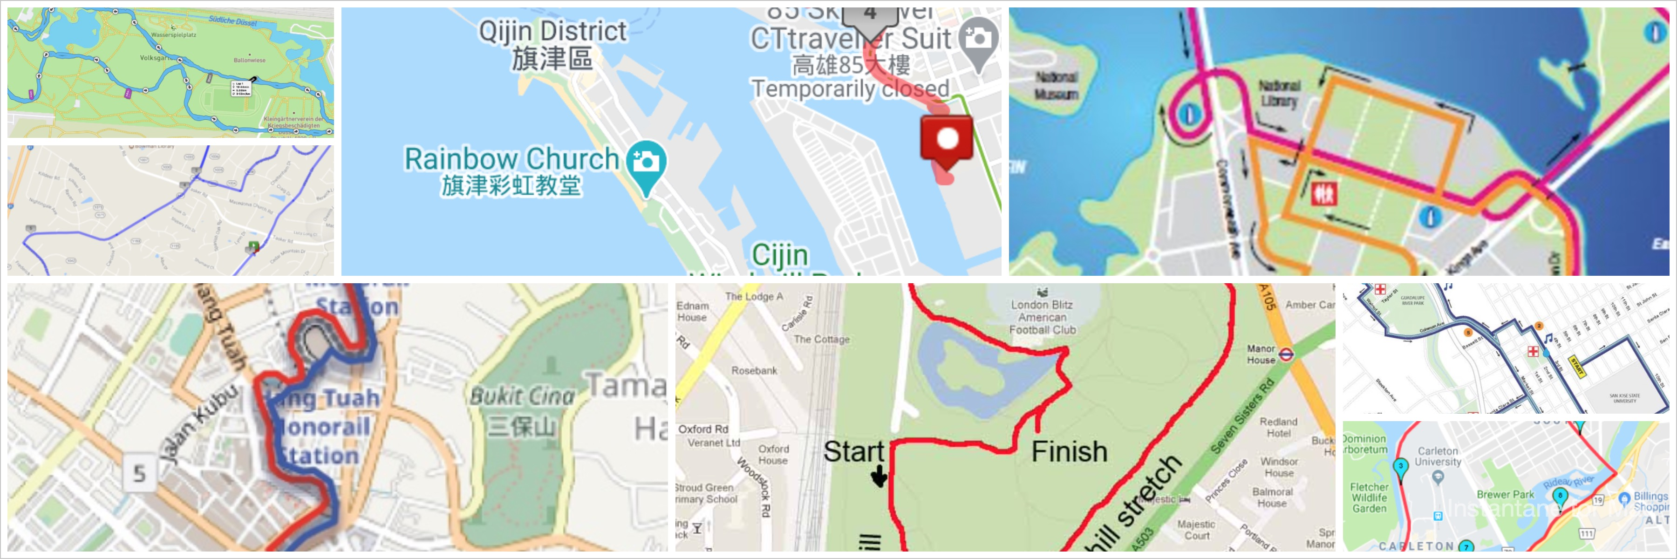
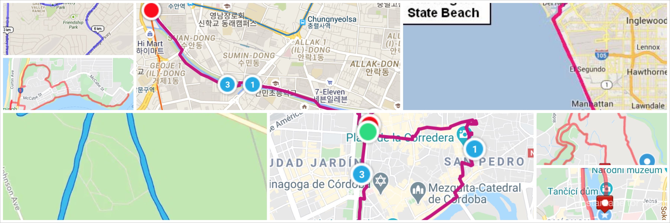
Classifying Running Routes
Carla Moestafa
METIS DS Winter 2021 Final Project

Slide 3
riverside run
park run
seaside run
city run
Image classification using convolutional neural networks
convolution layer(s)
pooling layer(s)
dense layer(s)
Notes:
https://privacyinternational.org/explainer/56/what-privacy:
Privacy is a qualified, fundamental human right. The right to privacy is articulated in all of the major international and regional human rights instruments, including:
The Universal Declaration of Human Rights articulates fundamental rights and freedoms for all. The General Assembly of the United Nations adopted the Declaration on 10 December 1948.
The Universal Declaration is not a treaty, so it does not directly create legal obligations (the breach of which does not entail non compliance)for countries.
However, it is an expression of the fundamental values which are shared by all members of the international community
United Nations Declaration of Human Rights (UDHR) 1948, Article 12: “No one shall be subjected to arbitrary interference with his privacy, family, home or correspondence, nor to attacks upon his honour and reputation. Everyone has the right to the protection of the law against such interference or attacks.” International Covenant on Civil and Political Rights (ICCPR) 1966, Article 17: “1. No one shall be subjected to arbitrary or unlawful interference with his privacy, family, home or correspondence, nor to unlawful attacks on his honour or reputation. 2. Everyone has the right to the protection of the law against such interference or attacks.”
The right to privacy is also included in:
Article 14 of the United Nations Convention on Migrant Workers;
Article 16 of the UN Convention on the Rights of the Child;
Article 10 of the African Charter on the Rights and Welfare of the Child;
Article 4 of the African Union Principles on Freedom of Expression (the right of access to information);
Article 11 of the American Convention on Human Rights;
Article 5 of the American Declaration of the Rights and Duties of Man,
Articles 16 and 21 of the Arab Charter on Human Rights;
Article 21 of the ASEAN Human Rights Declaration; and
Article 8 of the European Convention on Human Rights.
Article 12 states that “No one shall be subjected to arbitrary interference with his privacy, family, home or correspondence, nor to attacks upon his honour and reputation. Everyone has the right to the protection of the law against such interference or attacks.”
drafted by representatives from all over the world with a variety of legal and cultural backgrounds.
Indonesian :
Indonesian constitution
Article 28G (1) Every person shall have the right to protection of his/herself, family, honour, dignity, and property, and shall have the right to feel secure against and receive protection from the threat of fear to do or not do something that is a human right. (2) Every person shall have the right to be free from torture or inhumane and degrading treatment, and shall have the right to obtain political asylum from another country.

Slide 4
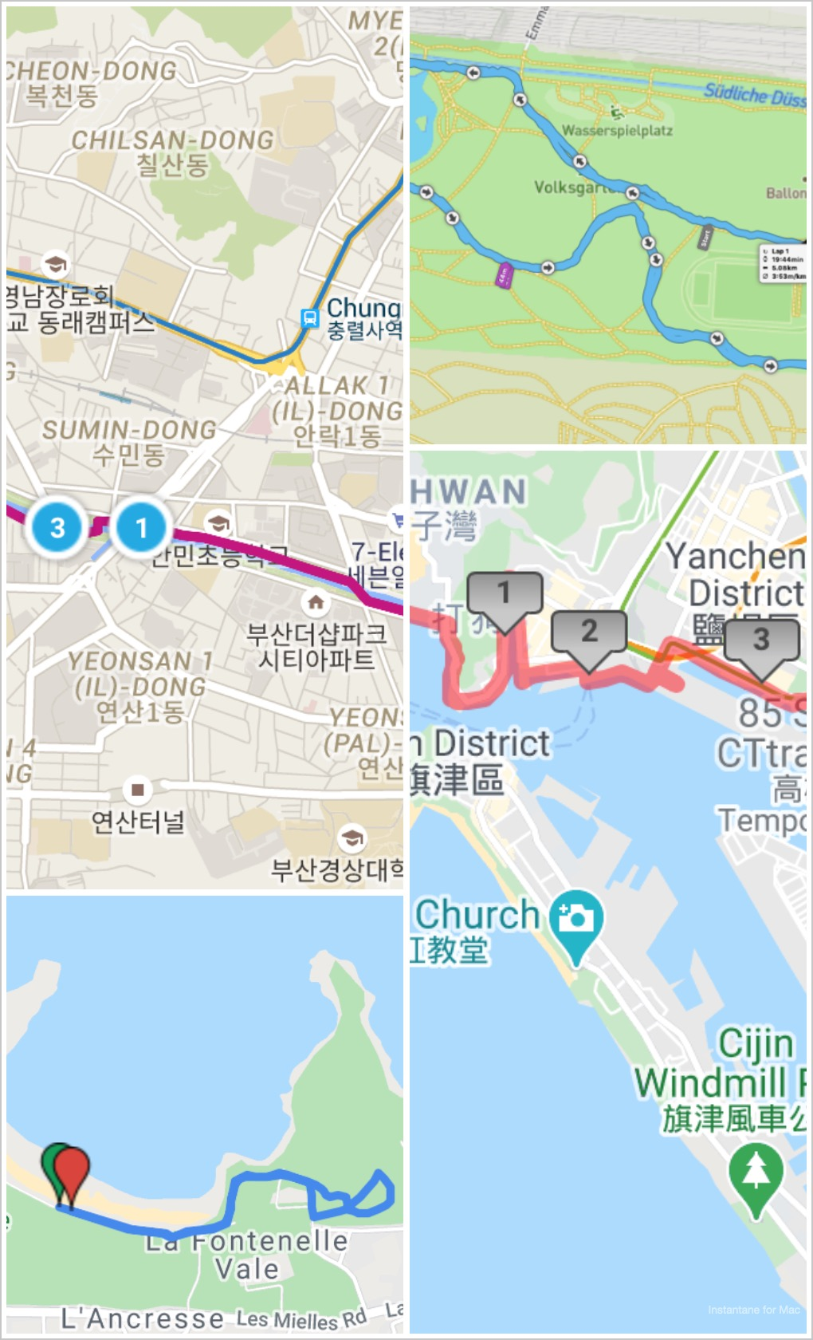
DATASET
500 running route screenshots
Resize to 224 x 224
4 classes:
city run, park run, riverside run and seaside run
Train & Validation: 400 pictures (100/class)
Test: 100 pictures (25/class)
Data Augmentation also included during the modeling
Notes:
The first global statement of privacy as a human rights is articulated in the United Nation Declaration of Human Rights in 1948
United Nations Declaration of Human Rights (UDHR) 1948, Article 12: (non legally binding)
“No one shall be subjected to arbitrary interference with his privacy, family, home or correspondence, nor to attacks upon his honour and reputation. Everyone has the right to the protection of the law against such interference or attacks.”
International Covenant on Civil and Political Rights (ICCPR) 1966, Article 17: (legally binding treaty)
“1. No one shall be subjected to arbitrary or unlawful interference with his privacy, family, home or correspondence, nor to unlawful attacks on his honour or reputation. 2. Everyone has the right to the protection of the law against such interference or attacks.”
The right to privacy is also included in:
Article 14 of the United Nations Convention on Migrant Workers;
Article 16 of the UN Convention on the Rights of the Child;
Article 10 of the African Charter on the Rights and Welfare of the Child;
Article 4 of the African Union Principles on Freedom of Expression (the right of access to information);
Article 11 of the American Convention on Human Rights;
Article 5 of the American Declaration of the Rights and Duties of Man,
Articles 16 and 21 of the Arab Charter on Human Rights;
Article 21 of the ASEAN Human Rights Declaration; and
Article 8 of the European Convention on Human Rights.

Slide 5
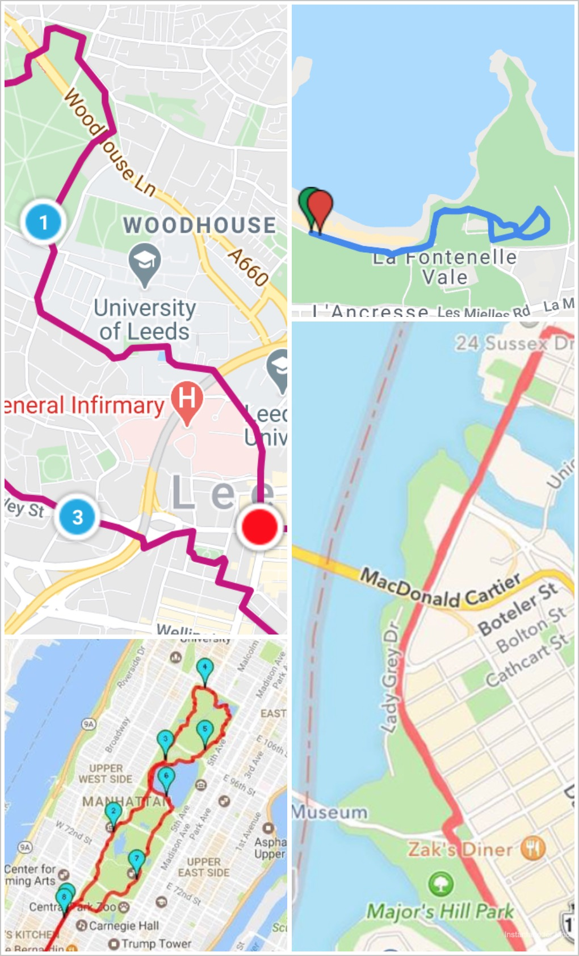
DATA AUGMENTATION
Rotation: 10 -40 (10)
Width shift: 0.1 – 1 (0.5)
Height shift: 0.1 – 0.5 (0.1)
Zoom: 0.1 – 1.5 (0.5)
Shear range: 0.1 – 0.5 (0.25)
Within ( ) = number used in the latest selected model
Notes:
The first global statement of privacy as a human rights is articulated in the United Nation Declaration of Human Rights in 1948
United Nations Declaration of Human Rights (UDHR) 1948, Article 12: (non legally binding)
“No one shall be subjected to arbitrary interference with his privacy, family, home or correspondence, nor to attacks upon his honour and reputation. Everyone has the right to the protection of the law against such interference or attacks.”
International Covenant on Civil and Political Rights (ICCPR) 1966, Article 17: (legally binding treaty)
“1. No one shall be subjected to arbitrary or unlawful interference with his privacy, family, home or correspondence, nor to unlawful attacks on his honour or reputation. 2. Everyone has the right to the protection of the law against such interference or attacks.”
The right to privacy is also included in:
Article 14 of the United Nations Convention on Migrant Workers;
Article 16 of the UN Convention on the Rights of the Child;
Article 10 of the African Charter on the Rights and Welfare of the Child;
Article 4 of the African Union Principles on Freedom of Expression (the right of access to information);
Article 11 of the American Convention on Human Rights;
Article 5 of the American Declaration of the Rights and Duties of Man,
Articles 16 and 21 of the Arab Charter on Human Rights;
Article 21 of the ASEAN Human Rights Declaration; and
Article 8 of the European Convention on Human Rights.

Slide 6
riverside run
park run
seaside run
city run
SELECTED MODEL FROM LATEST MODELING ITERATION
Conv2D 32
Dense 512
Conv2D 64
MaxPooling2D
Dense 4
Conv2D 128
Notes:
https://privacyinternational.org/explainer/56/what-privacy:
Privacy is a qualified, fundamental human right. The right to privacy is articulated in all of the major international and regional human rights instruments, including:
The Universal Declaration of Human Rights articulates fundamental rights and freedoms for all. The General Assembly of the United Nations adopted the Declaration on 10 December 1948.
The Universal Declaration is not a treaty, so it does not directly create legal obligations (the breach of which does not entail non compliance)for countries.
However, it is an expression of the fundamental values which are shared by all members of the international community
United Nations Declaration of Human Rights (UDHR) 1948, Article 12: “No one shall be subjected to arbitrary interference with his privacy, family, home or correspondence, nor to attacks upon his honour and reputation. Everyone has the right to the protection of the law against such interference or attacks.” International Covenant on Civil and Political Rights (ICCPR) 1966, Article 17: “1. No one shall be subjected to arbitrary or unlawful interference with his privacy, family, home or correspondence, nor to unlawful attacks on his honour or reputation. 2. Everyone has the right to the protection of the law against such interference or attacks.”
The right to privacy is also included in:
Article 14 of the United Nations Convention on Migrant Workers;
Article 16 of the UN Convention on the Rights of the Child;
Article 10 of the African Charter on the Rights and Welfare of the Child;
Article 4 of the African Union Principles on Freedom of Expression (the right of access to information);
Article 11 of the American Convention on Human Rights;
Article 5 of the American Declaration of the Rights and Duties of Man,
Articles 16 and 21 of the Arab Charter on Human Rights;
Article 21 of the ASEAN Human Rights Declaration; and
Article 8 of the European Convention on Human Rights.
Article 12 states that “No one shall be subjected to arbitrary interference with his privacy, family, home or correspondence, nor to attacks upon his honour and reputation. Everyone has the right to the protection of the law against such interference or attacks.”
drafted by representatives from all over the world with a variety of legal and cultural backgrounds.
Indonesian :
Indonesian constitution
Article 28G (1) Every person shall have the right to protection of his/herself, family, honour, dignity, and property, and shall have the right to feel secure against and receive protection from the threat of fear to do or not do something that is a human right. (2) Every person shall have the right to be free from torture or inhumane and degrading treatment, and shall have the right to obtain political asylum from another country.

Slide 7
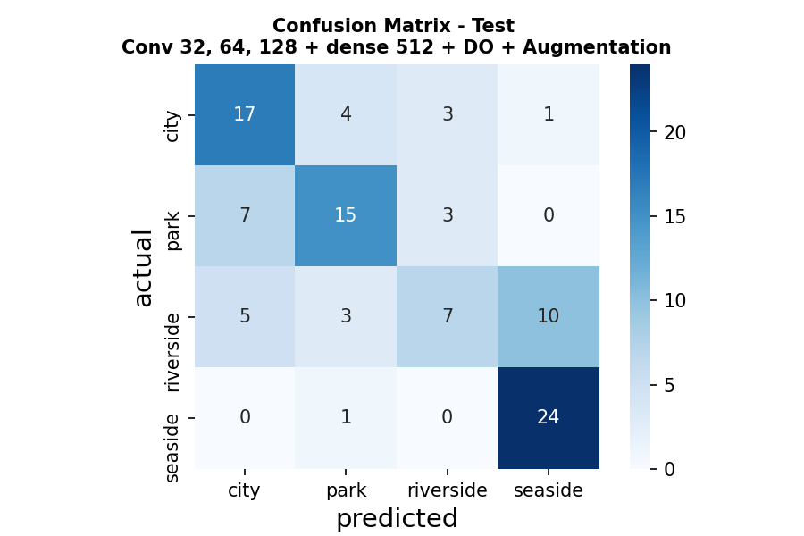
SELECTED MODEL TEST RESULTS
Accuracy: 0.63
 | Precision | Recall | F1- score
City Run | 0.59 | 0.68 | 0.63
Park Run | 0.65 | 0.60 | 0.63
Riverside Run | 0.54 | 0.28 | 0.37
Seaside Run | 069 | 0.96 | 0.80
Notes:
The first global statement of privacy as a human rights is articulated in the United Nation Declaration of Human Rights in 1948
United Nations Declaration of Human Rights (UDHR) 1948, Article 12: (non legally binding)
“No one shall be subjected to arbitrary interference with his privacy, family, home or correspondence, nor to attacks upon his honour and reputation. Everyone has the right to the protection of the law against such interference or attacks.”
International Covenant on Civil and Political Rights (ICCPR) 1966, Article 17: (legally binding treaty)
“1. No one shall be subjected to arbitrary or unlawful interference with his privacy, family, home or correspondence, nor to unlawful attacks on his honour or reputation. 2. Everyone has the right to the protection of the law against such interference or attacks.”
The right to privacy is also included in:
Article 14 of the United Nations Convention on Migrant Workers;
Article 16 of the UN Convention on the Rights of the Child;
Article 10 of the African Charter on the Rights and Welfare of the Child;
Article 4 of the African Union Principles on Freedom of Expression (the right of access to information);
Article 11 of the American Convention on Human Rights;
Article 5 of the American Declaration of the Rights and Duties of Man,
Articles 16 and 21 of the Arab Charter on Human Rights;
Article 21 of the ASEAN Human Rights Declaration; and
Article 8 of the European Convention on Human Rights.

Slide 8
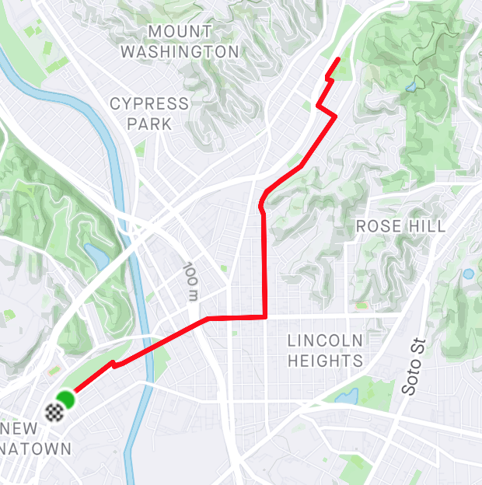
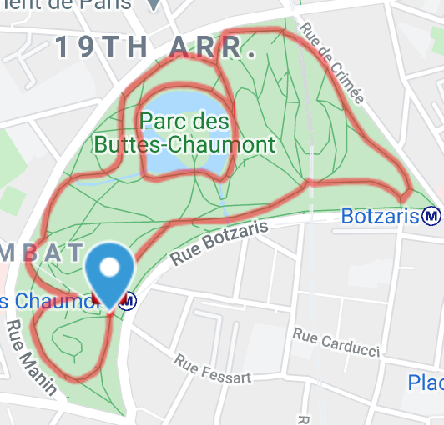
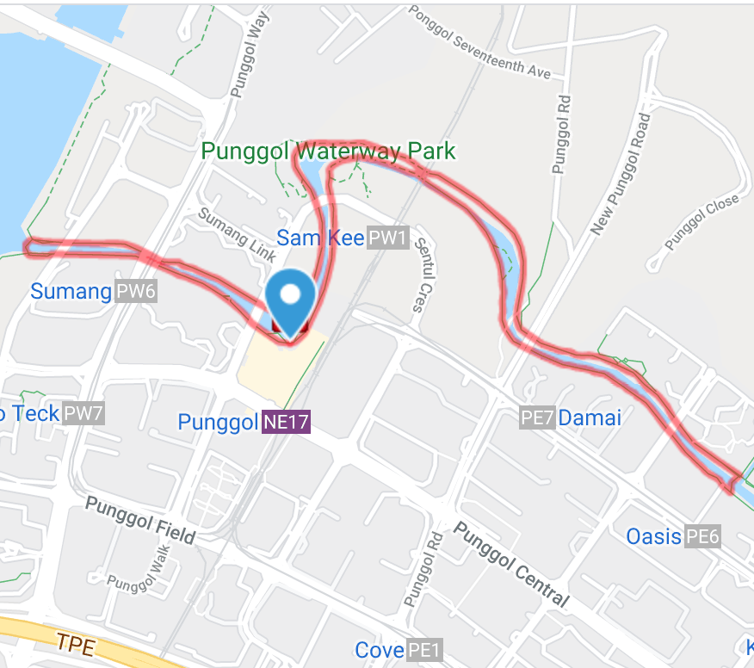
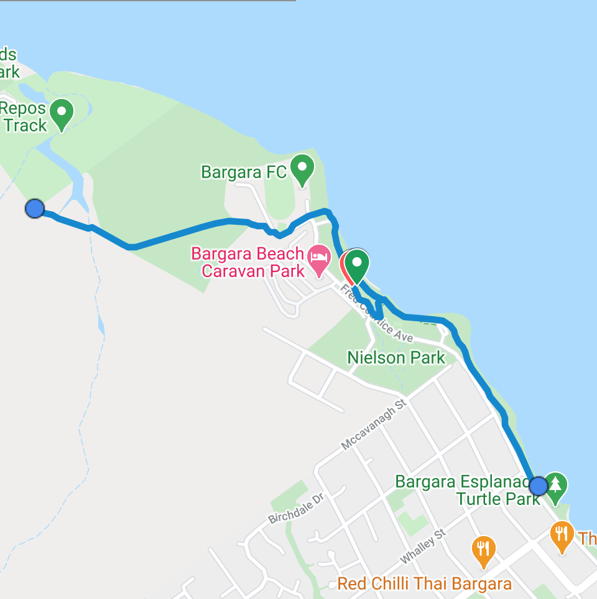
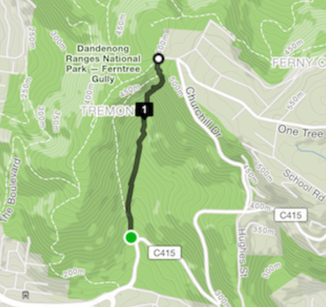
model.predict
Labelled :
Predicted :
Predicted Probabilities :
Class 0 – City Run
Class 2 – Park Run
Class 3 – Riverside Run
Class 4 - Seaside run
City Run
City Run
0.34
0.30
0.27
0.09
Park Run
Park Run
0.32
0.34
0.27
0.07
River Run
City Run
0.34
0.26
0.31
0.09
Seaside Run
Seaside Run
0.1
0.04
0.18
0.68
Park Run
Park Run
0.25
0.57
0.15
0.03
Notes:
The first global statement of privacy as a human rights is articulated in the United Nation Declaration of Human Rights in 1948
United Nations Declaration of Human Rights (UDHR) 1948, Article 12: (non legally binding)
“No one shall be subjected to arbitrary interference with his privacy, family, home or correspondence, nor to attacks upon his honour and reputation. Everyone has the right to the protection of the law against such interference or attacks.”
International Covenant on Civil and Political Rights (ICCPR) 1966, Article 17: (legally binding treaty)
“1. No one shall be subjected to arbitrary or unlawful interference with his privacy, family, home or correspondence, nor to unlawful attacks on his honour or reputation. 2. Everyone has the right to the protection of the law against such interference or attacks.”
The right to privacy is also included in:
Article 14 of the United Nations Convention on Migrant Workers;
Article 16 of the UN Convention on the Rights of the Child;
Article 10 of the African Charter on the Rights and Welfare of the Child;
Article 4 of the African Union Principles on Freedom of Expression (the right of access to information);
Article 11 of the American Convention on Human Rights;
Article 5 of the American Declaration of the Rights and Duties of Man,
Articles 16 and 21 of the Arab Charter on Human Rights;
Article 21 of the ASEAN Human Rights Declaration; and
Article 8 of the European Convention on Human Rights.

Slide 9
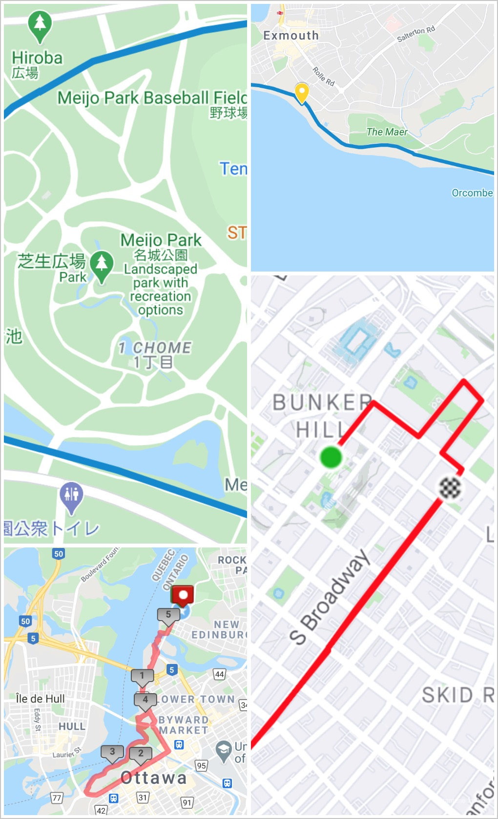
TRAINING & VALIDATION
Training & Validation Accuracy results from the modeling iterations :
dense classifier only: approx 0.2– 0.3
1 block of Conv2D : up to 0.4
3 layers of Conv2D: up to 0.6
VGG16: at best, similar to 3 blocks of Conv2D + MaxPooling2D
Notes:
The first global statement of privacy as a human rights is articulated in the United Nation Declaration of Human Rights in 1948
United Nations Declaration of Human Rights (UDHR) 1948, Article 12: (non legally binding)
“No one shall be subjected to arbitrary interference with his privacy, family, home or correspondence, nor to attacks upon his honour and reputation. Everyone has the right to the protection of the law against such interference or attacks.”
International Covenant on Civil and Political Rights (ICCPR) 1966, Article 17: (legally binding treaty)
“1. No one shall be subjected to arbitrary or unlawful interference with his privacy, family, home or correspondence, nor to unlawful attacks on his honour or reputation. 2. Everyone has the right to the protection of the law against such interference or attacks.”
The right to privacy is also included in:
Article 14 of the United Nations Convention on Migrant Workers;
Article 16 of the UN Convention on the Rights of the Child;
Article 10 of the African Charter on the Rights and Welfare of the Child;
Article 4 of the African Union Principles on Freedom of Expression (the right of access to information);
Article 11 of the American Convention on Human Rights;
Article 5 of the American Declaration of the Rights and Duties of Man,
Articles 16 and 21 of the Arab Charter on Human Rights;
Article 21 of the ASEAN Human Rights Declaration; and
Article 8 of the European Convention on Human Rights.

Slide 10
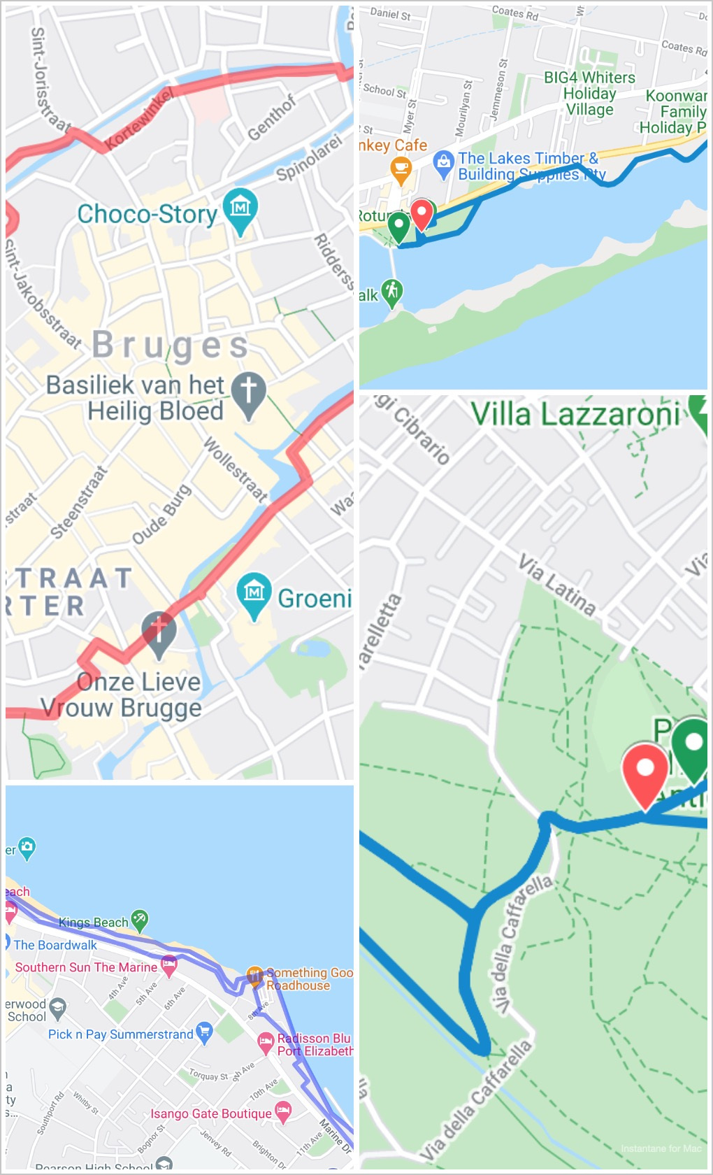
POTENTIAL USE
Use in a recommender system, for examples:
Recommendation for similar routes nearby or in another city
Recommendation for running apparel stores nearby, etc.
Notes:
The first global statement of privacy as a human rights is articulated in the United Nation Declaration of Human Rights in 1948
United Nations Declaration of Human Rights (UDHR) 1948, Article 12: (non legally binding)
“No one shall be subjected to arbitrary interference with his privacy, family, home or correspondence, nor to attacks upon his honour and reputation. Everyone has the right to the protection of the law against such interference or attacks.”
International Covenant on Civil and Political Rights (ICCPR) 1966, Article 17: (legally binding treaty)
“1. No one shall be subjected to arbitrary or unlawful interference with his privacy, family, home or correspondence, nor to unlawful attacks on his honour or reputation. 2. Everyone has the right to the protection of the law against such interference or attacks.”
The right to privacy is also included in:
Article 14 of the United Nations Convention on Migrant Workers;
Article 16 of the UN Convention on the Rights of the Child;
Article 10 of the African Charter on the Rights and Welfare of the Child;
Article 4 of the African Union Principles on Freedom of Expression (the right of access to information);
Article 11 of the American Convention on Human Rights;
Article 5 of the American Declaration of the Rights and Duties of Man,
Articles 16 and 21 of the Arab Charter on Human Rights;
Article 21 of the ASEAN Human Rights Declaration; and
Article 8 of the European Convention on Human Rights.

Slide 11

CONCLUSION
Despite the small dataset and similar features found within the pictures of different categories, the convnet model was able to classify the running images reasonably well.
Better and more stable results might be obtained with a larger dataset.
Notes:
The first global statement of privacy as a human rights is articulated in the United Nation Declaration of Human Rights in 1948
United Nations Declaration of Human Rights (UDHR) 1948, Article 12: (non legally binding)
“No one shall be subjected to arbitrary interference with his privacy, family, home or correspondence, nor to attacks upon his honour and reputation. Everyone has the right to the protection of the law against such interference or attacks.”
International Covenant on Civil and Political Rights (ICCPR) 1966, Article 17: (legally binding treaty)
“1. No one shall be subjected to arbitrary or unlawful interference with his privacy, family, home or correspondence, nor to unlawful attacks on his honour or reputation. 2. Everyone has the right to the protection of the law against such interference or attacks.”
The right to privacy is also included in:
Article 14 of the United Nations Convention on Migrant Workers;
Article 16 of the UN Convention on the Rights of the Child;
Article 10 of the African Charter on the Rights and Welfare of the Child;
Article 4 of the African Union Principles on Freedom of Expression (the right of access to information);
Article 11 of the American Convention on Human Rights;
Article 5 of the American Declaration of the Rights and Duties of Man,
Articles 16 and 21 of the Arab Charter on Human Rights;
Article 21 of the ASEAN Human Rights Declaration; and
Article 8 of the European Convention on Human Rights.

